Slide 1
Capstone Project - The Battle of Neighborhoods
Bo Xue

Slide 2
Introduction/Business Problem
Asian cuisine is also very popular in the US, especially cities full of Asian immigrants, like the Silicon Valley in California.
Bubble tea is growing more and more popular, bubble tea stores often have a long queue in some hot business areas
This project aims to find the best location to open a business in a city in Silicon Valley, San Jose, CA
It’s important to know if it is profitable prior to launching any business, so this report will try to gather data about similar businesses in the neighborhood and potential customer distribution, competitors, etc.
The data can be used as part of a business plan to support making decision.

Slide 3
Data Descritpion
I will use Foursquare API to find venues:
For competitor study
Existing Bubble Tea shops around the neighborhoods in San Jose
Similar businesses around the neighborhoods in San Jose
For potential customer distribution study
Universities around the neighborhoods in San Jose
Companies around the neighborhoods in San Jose
Data visualization: I will use folium the map rendering library to visualize the venues

Slide 4
Methodology
City partitioning
Create a hexagonal grid of cells: offset every other row, and adjust vertical row spacing so that every cell center is equally distant from all it's neighbors.
All following data manipulations are operated against each of the cells
Get all bubble tea shops and coffee shops/Cafe in each area cell using the foursquare API (category approach)
Find potential customer spots in each area cell with foursquare API category approach (universities and companies)
Then we can calculate average number of customers (Entity of universities/companies)
Candidate place can be found among the areas that have highest customer/existing-biz ratio

Slide 5
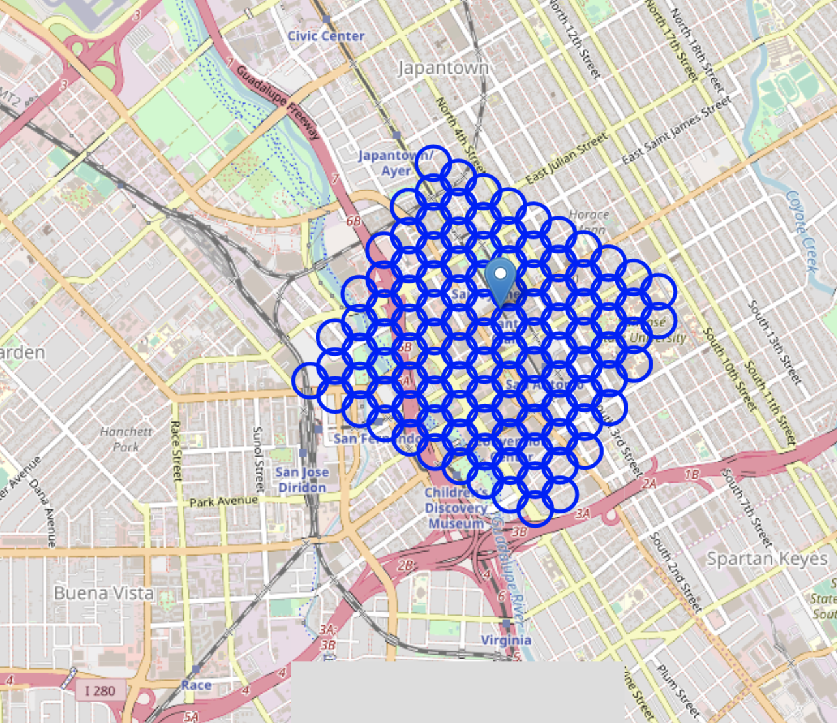
City partitioning

Slide 6
Result
Existing business situation
Potential customer cluster situation
Candidate areas that have profit potential

Slide 7
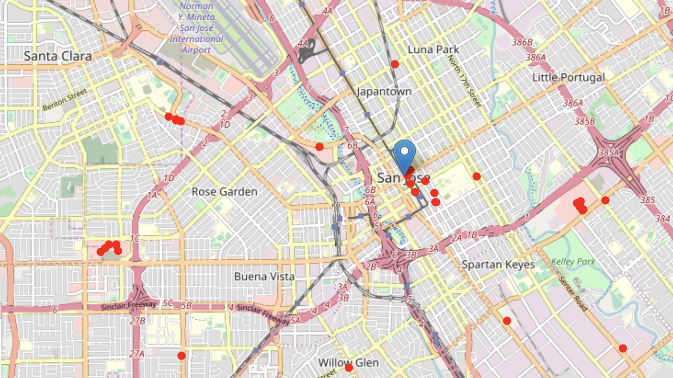
Result
Existing business situation
Total number of bubble tea shops: 32
Total number of other coffee shops or cafes: 0
Percentage of bubble tea shops in the tea/coffee biz: 100.00%

Slide 8
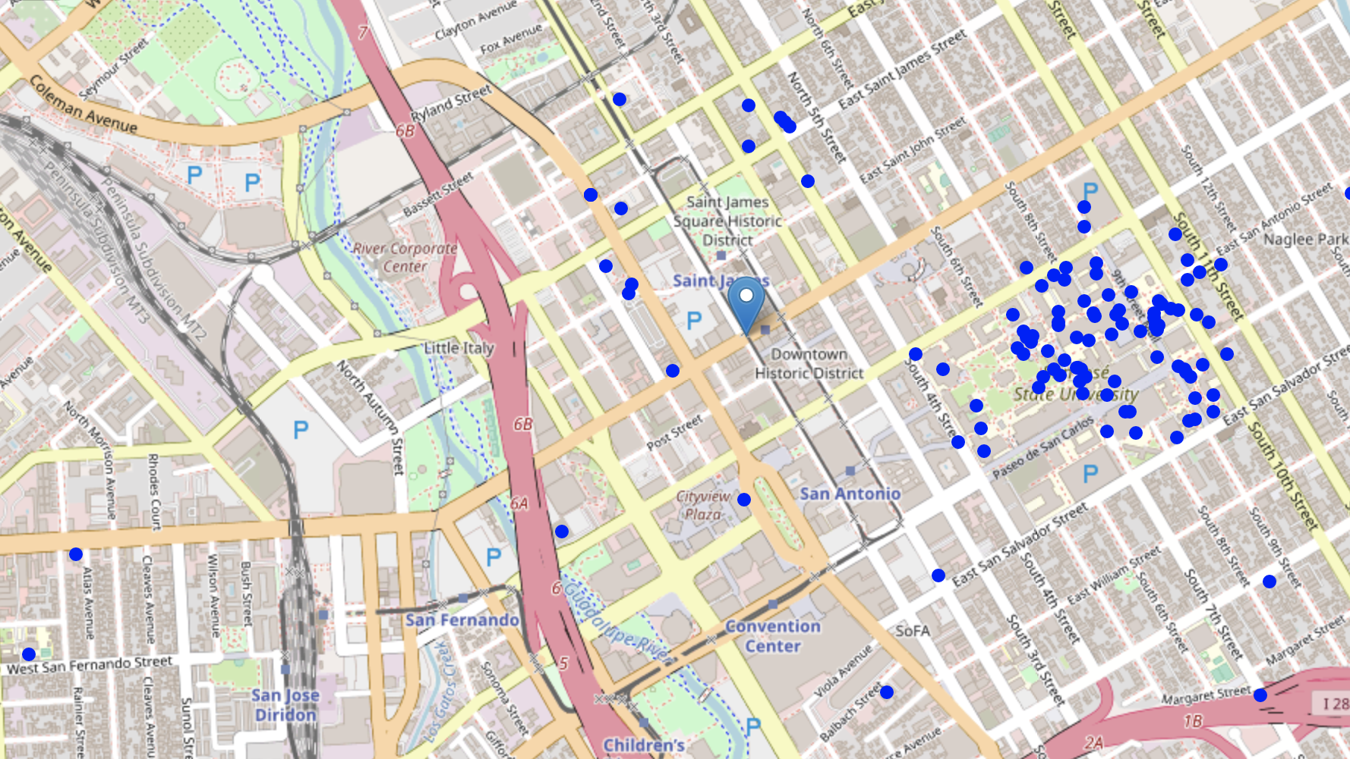
Result
Existing business situation
Potential customer cluster situation
Total number of universities: 199

